Slide 1


Bitcoin and ICO --Startups in the Bitcoin & Blockchain space
LING Zong, Ph. D.
Senior Software Engineer / Scientist
IBM Almaden Research Center
San Jose, California, U.S.A.
Notes:
Thanks, pleasure etc.
There is much hype around Blockchain.
Most of this relates to the use of Blockchain to underpin the Bitcoin crypto currency.
Whilst IBM are not interested in Crypto currency, we are very interested in exploring the broader business application of Blockchain technology. This is a transformational opportunity for many of our clients
This touches most all industries – we are making Blockchain REAL for business.

Slide 2
Section Outline
Venture Capitalist (VC) - What is a VC - VC’s in Crypto - Current Investments
Initial Coin Offerings - What is an ICO vs. IPO - Process of ICO - Current (successful ICO’s)
Securities Token Offering

Slide 3
Venture Capitalists

Slide 4
How to get funding?
There are couple of ways:
Family, friends & Relatives
Venture Capital
Angel Investor
ICO (Initial Coin Offering)
Crowdsourcing

Slide 5

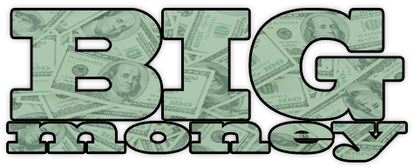
Venture Capitalists
A fund which invests money into starting/emerging companies
OPM (Other People's Money)
Different funds
Angels
Current Angels
Old fashioned
Angels
A
B
C
Notes:
Currently we see a lot of seed investment going into Blockchain and Bitcoin companies but not enough to push this disruption forward. For example multiple billions go in to other different technologies as apps and other software.
So 1.3Billion is nothing compared to the other industry

Slide 6
Angel Investor
An angel investor (also known as a business angel, informal investor, angel funder, private investor, or seed investor) is an affluent individual who provides capital for a business start-up, usually in exchange for convertible debt or ownership equity.
A small but increasing number of angel investors invest online through equity crowdfunding or organize themselves into angel groups or angel networks to share research and pool their investment capital, as well as to provide advice to their portfolio companies
Angels
A
B
C
Notes:
https://en.wikipedia.org/wiki/Angel_investor

Slide 7





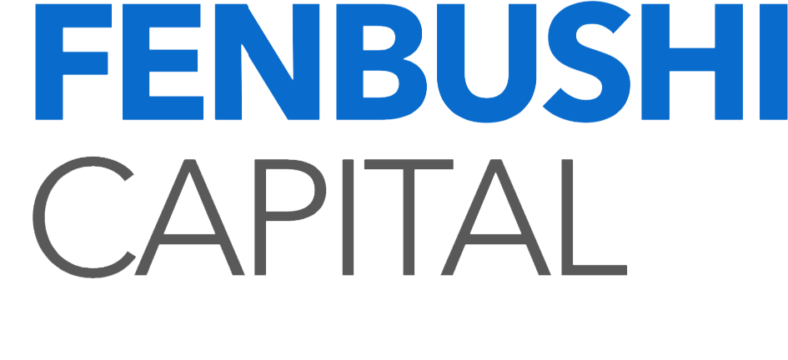

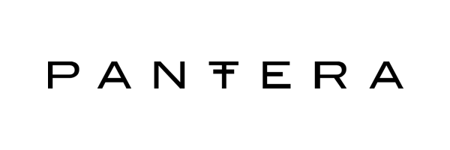

Amount Invested & VC’s
121 Mil
+/- 1.3 Billion (Total all time)
+/- 2.5 Million Average
Mainly Seed Investment
When to catch the wave, where is bitcoin?
But there are some really big players…
60 Mil
40 Mil
136 Mil
76 Mil
Source: http://www.coindesk.com/bitcoin-venture-capital/
http://www.coindesk.com/10-vc-firms-bullish-on-bitcoins-potential/
Notes:
There are trust issues
Andriessen Horrowitz current VC - traditional VC that investst in Bitcoin/Blockchain

Slide 8
Initial Coin Offerings
Notes:
The Disruption is begin held by the other investors and we need to find a different way to push ourselves and the industry forward, the ICO

Slide 9
What is ICO?
InCrowdsourcing/funding
Offering the first coin of the platform
No equity give away
The community invests
Initial Coin Offering
List of ongoing ICOs: https://www.icohotlist.com
Source http://startupmanagement.org/2016/10/06/how-cryptocurrencies-and-blockchain-based-startups-are-turning-the-traditional-venture-capital-model-on-its-head/
Notes:
https://en.wikipedia.org/wiki/Initial_coin_offering

Slide 10


Pros & Cons
Pros:
No equity giveaway
No outside interference
Marketing advantage
VCs Stay away
Easy money
Cons:
High Risk
A lot of scams
Due dilligence
No VC experience
Long term vision & strategy
People are in for money
There is no control
Notes:
ICOs carry significant strategic advantages: The business retains its independence, does not have to give away any equity (though this depends on the type of token it uses) and has no outside interference in its board.
The application in question gets access to an engaged community of users and investors. In a way, it efficiently takes care of the financing and marketing at the same time.
ICOs are easier to pull off than VC investment, since the business does not have to run the gamut of vetting by analysts and seasoned investors. The "market" will decide if the idea is good or not.
For many, ICOs may be the only option. VC investors are probably staying away from ethereum businesses for now because of the digital currency's relative youth. And The DAO hack as well as recent DDoS attacks on its blockchain will almost certainly have impacted their eagerness to jump into untested waters.

Slide 11
Ideal ICO
Scam protection
Technology check
Proof of ability to execute
Business viability check
Efficient use of funds and business-based thresholds for minimum and maximum raise
A defined legal framework
A transparent ICO process
Escrow
Controlled release of funds
Delayed founder liquidity
Source: https://medium.com/iconominet/ico-2-0-what-is-the-ideal-ico-ee9d285a8939#.grad2ix81
Notes:
Scam protection
Technology check
Proof of ability to execute
Business viability check
Efficient use of funds and business-based thresholds for minimum and maximum raise
A defined legal framework
A transparent ICO process
Escrow
Controlled release of funds
Delayed founder liquidity

Slide 12
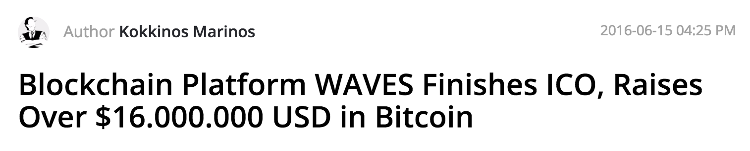

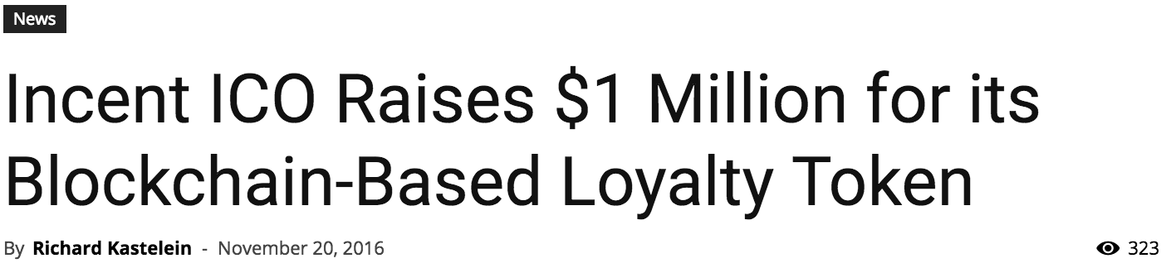

Succesful ICOs
https://wavesplatform.com
https://www.smithandcrown.com/sale/incent-loyalty/

Slide 13
VC vs ICO
VC vs. ICO | Traditional Venture Capital | ICO’s
1. Return Horizon | 7-10 Years | 1-5 Years
2. Ownership Model | Preferred Shares | Shares/Tokens/Crypto
3. Entry Phases | Angel/Seed/ Early to Late stage | Pre-mine/Genesis/ICO/Exchanges/Buy from company
4. Exit Method | Acquisition/IPO | Acquisition/ICO or Exchange listing
5. Business Model | Selling product or service | Creating a self sustaining Circular Economy based on own coin/currency
6. Legal Structure | Standard LLC via corporate law in given jurisdiction | LLC Creates technology and runs separate business on top of it or creates a valuable eco-system/or non registered DAO
7. Market Approach | Creating new models or new ones | Creating new business model

Slide 14
Securities Token Offering
Notes:
The Disruption is begin held by the other investors and we need to find a different way to push ourselves and the industry forward, the ICO

Slide 15
Securities Token Offering
A security token offering (STO) / tokenized IPO is a type of public offering in which tokenized digital securities, known as security tokens, are sold in cryptocurrency exchanges, or security token exchanges.
Tokens can be used to trade real financial assets such as equities and fixed income, and use a blockchain virtual ledger system to store and validate token transactions.
Due to tokens being classified as securities, STOs are more susceptible to regulation and thus represent a more secure investment alternative than ICOs, which have been subject to numerous fraudulent schemes.
Furthermore, since ICOs are not held in traditional exchanges, they can be a less expensive funding source for small and medium-sized companies when compared to an IPO.
An STO on a regulated stock exchange (referred to as a tokenized IPO) has the potential to deliver significant efficiencies and cost savings.
There have been various STOs globally. The STO database STOCheck.com has identified 88 projects until now. The largest STO was tZERO that raised over $130 million. The success rate of the projects lies somewhere near the 50% threshold. Ethereum is the leading blockchain platform used for issuance. Stellar comes in second position with a major German STO of the restaurant chain L'Osteria in late 2019 that was executed by the banking platform Kapilendo
Notes:
https://en.wikipedia.org/wiki/Security_token_offering

Slide 16
ICO or STO: Who Wins?
An STO is similar to an ICO in that an offering is made by a business to the crowd, in which consumers purchase crypto tokens built on a blockchain, but the two do not share many similarities beyond that.
Whereas ICOs are the sale of coins, purported utilities or even currencies, STOs are the sale of securities.
STO participants are investors, not users, who pay and receive a security (i.e. equity, debt, revenue share, etc) that is represented by a token.
In order to sell securities to the crowd, a company has to register the offering with the SEC (difficult and expensive) or use an exemption from said registration.
Source: https://hackernoon.com/ico-or-sto-who-wins-fd43c3ee7b8d

Slide 17
Section Outline
Venture Capitalist (VC) - What is a VC - VC’s in Crypto - Current Investments
Initial Coin Offerings - What is an ICO vs. IPO - Process of ICO - Current (successful ICO’s)
Securities Token Offering

Slide 18









完
Hindi
Traditional Chinese
Thai
Gracias
Russian
Thank You
Spanish
Obrigado
English
Brazilian Portuguese
Arabic
Danke
Grazie
German
Italian
Simplified Chinese
Merci
French
Japanese
Korean
Notes:
18

